Slide 1
Project 5
IMDB Movie Analysis
Hyperlink to the Excel Sheet: Please open the presentation and excel sheet in Microsoft software as opening in Google is changing the layout and plots *
https://docs.google.com/spreadsheets/d/1fF9exLYT5sbCRDmin6u7m-XetyquMaJS/edit?usp=sharing&ouid=111775799564275591184&rtpof=true&sd=trueHyperlink to the iPython Notebook:
https://drive.google.com/file/d/1r6oTeNwsm_Zf6cVTk9aFhPUt1pRtMJ7W/view?usp=sharing
Loom Presentation: https://www.loom.com/share/30b8df8518ac47f0b47235e0372b3c88?sid=a7745cdf-2533-4ba6-af38-2e0e0d459155

Slide 2

Project Description
This Project is about giving insights about success of a Movie based on IMDB data provided.
These insights will be helpful for filmmakers and other stakeholders during production of a movie
As a Data Analyst, we received dataset with details about movies with their IMDB Score and queries and we are required to analyze the data and provide insights to those queries.
To do this, we will use Python programming language for data pre-processing and Microsoft Excel software to extract and filter data from the pre-processed dataset and analyse them to get the required insights.
Image Source: Google Images

Slide 3

Approach
We had received a dataset containing information about movies from IMDB Database like director name, actor names, genres, plot keywords, budget, gross collection, IMDB Score etc.
We first tried to understand the whole dataset.
Then we performed Data Pre-Processing where we checked and did necessary changes for missing data, error in data, outliers in data and duplicates in data.
Then we directly started filtering data as per the queries we had. We also plotted some graphs for better understanding. Then we drew conclusions and insights based on the filtered data and the plots.
Now, since we got all the insights required, we will make a detailed report about it and hand them over to the hiring department.
Image Source: Google Images

Slide 4



Tech-Stack Used
Python 3.10.9 – Programming language used for Data Pre-processing
Jupyter Notebook 6.5.2 – Interactive platform to write and execute codes in various programming languages (in this case Python).
Microsoft Excel 2021 – A spreadsheet editor software used mainly by professionals to enter data in table format, perform computations, plot graphs etc. Here Microsoft Excel is used to filter data and plot graphs to get insights about the movies
Image Source: Google Images

Slide 5
Dataset Information (column)
color: Whether movie is colored or black and white
director_name: Name of the Diretor
num_critic_for_reviews: Number of critics that gave reviews for the movie
duration: Duration of the movie
director_facebook_likes: Number of facebook likes the director has
actor_3_facebook_likes: Number of facebook likes actor 3 has
actor_2_name: Name of actor 2
actor_1_facebook_likes: How many facebook likes actor 1 has
gross: Gross collection of the movie
genres: Genres of the movie
actor_1_name: Name of actor 1
movie_title: Name of the movie
num_voted_users: Number of users voted for the movie
cast_total_facebook_likes: Number of facebook likes the whole cast has together

Slide 6
Dataset Information (column)
actor_3_name: Name of actor 3
facenumber_in_poster: Number of faces in the movie poster
plot_keywords: Keywords of the movie plot
movie_imdb_link: Link to IMDB page of the movie
num_user_for_reviews: Number of users who gave review to the movie
language: Languag of the movie
country: Country in which the movie was made
content_rating: The certificate that the movie got
budget: Budget of the movie
title_year: Release year of the movie
actor_2_facebook_likes: Number of facebook likes actor 2 has
imdb_score: IMDB Score of the movie
aspect_ratio: The aspect ratio in which the movie was made
movie_facebook_likes: Number of facebook likes the movie has

Slide 7

Dataset Information
The dataset has 5043 rows and 28 columns in total

Slide 8
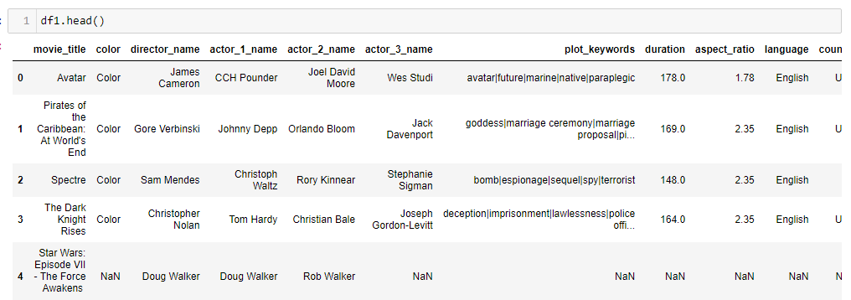
Data Pre-Processing
1. Rearranging columns of the dataset for convenience during analysis
Result:

Slide 9
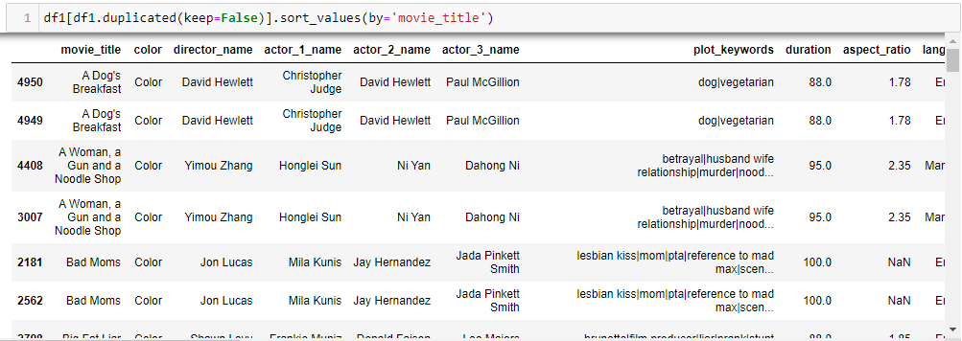
Data Pre-Processing
2. Checking for duplicates of entire row
Action:
Keeping one, dropped rest of the duplicates.

Slide 10
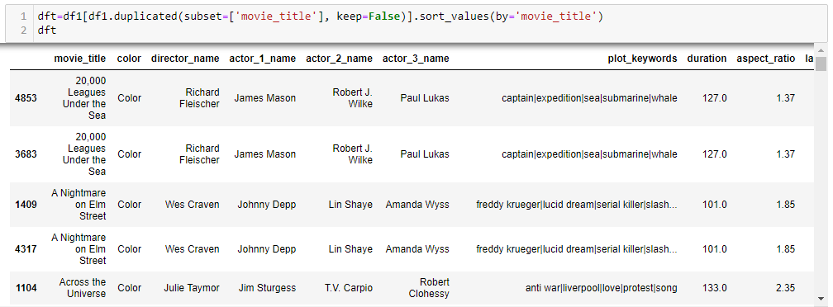
Data Pre-Processing
3 a. Checking for duplicates movie_title column

Slide 11
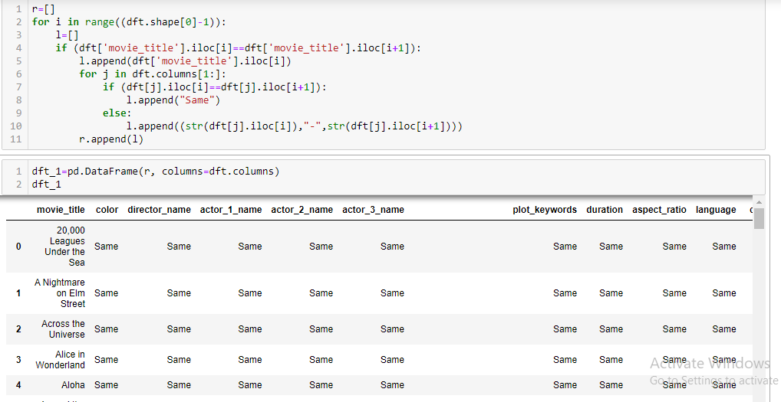
Data Pre-Processing
3 b. Further checking which column values are different for duplicate movie_title

Slide 12
Data Pre-Processing
Result:
From the above dataframe, we observed that except for movie "Out of the Blue" and "The Host", rest almost all the movies, the difference between column values for rows with same movie_title are in columns related to facebook likes and "num_voted_users". So we can drop the duplicate rows leaving just one copy of the row without much effect on the overall analysis.
Action:
We extracted only rows whose movie_title are not duplicate, the first instance of duplicate movie_title and all duplicates of movie_title of Out of the Blue and The Host.

Slide 13
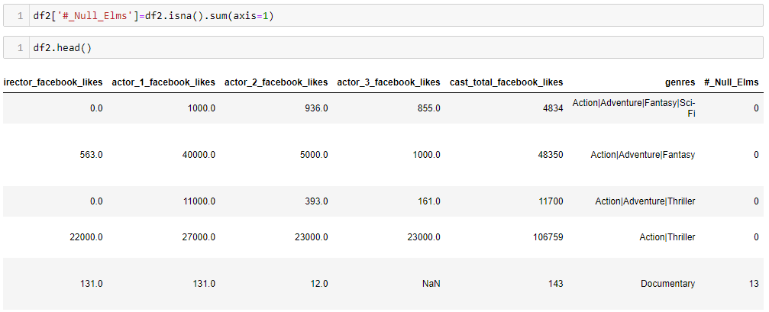
Data Pre-Processing
4 a. Checking for null values row wise

Slide 14
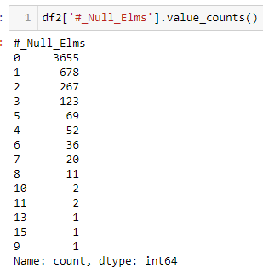
Data Pre-Processing
4 b. Checking frequency of row wise null values
Action:
We dropped all the rows where number of null values was greater than 9

Slide 15
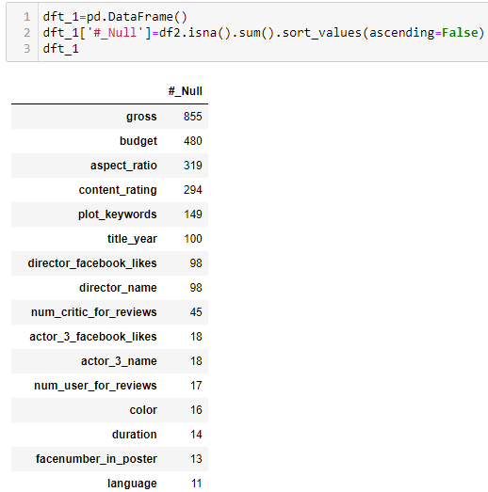
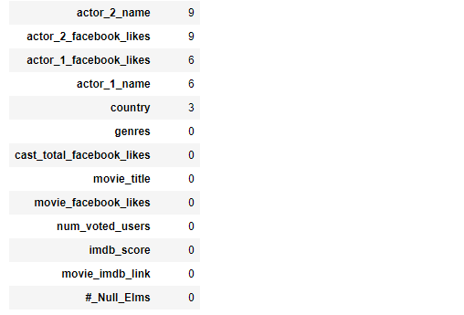
Data Pre-Processing
5. Checking for null values column wise

Slide 16
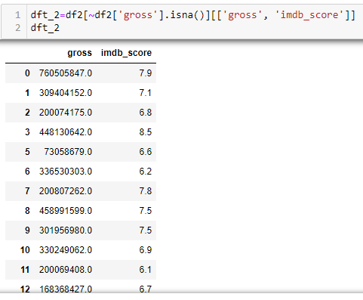
Data Pre-Processing
6. Dealing with Null values in gross column

Slide 17
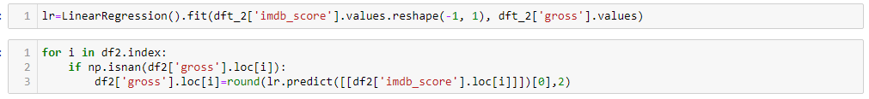
Data Pre-Processing
Action:
Fitting a Linear Regression model on imdb_score and gross and then predicting Gross value based on IMDB Score of the row with null value in gross.

Slide 18
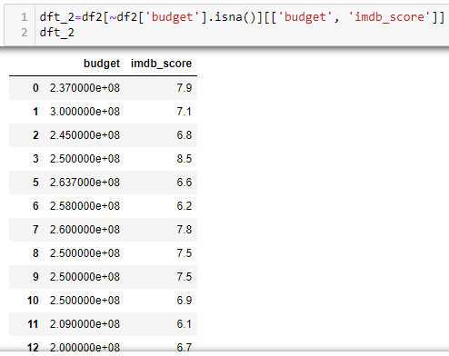
Data Pre-Processing
7. Dealing with Null values in budget column

Slide 19
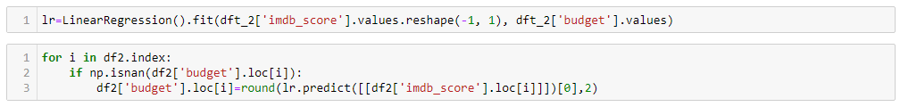
Data Pre-Processing
Action:
Fitting a Linear Regression model on imdb_score and budget and then predicting Gross value based on IMDB Score of the row with null value in budget.

Slide 20
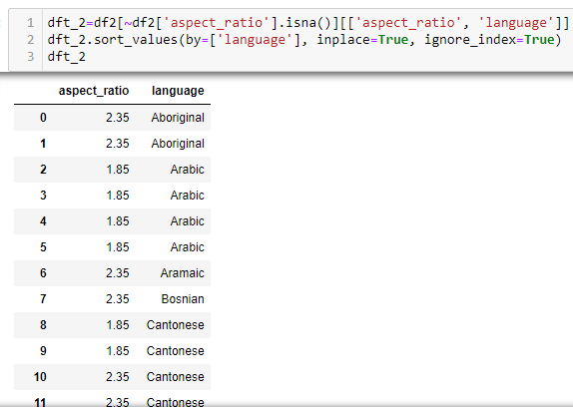
Data Pre-Processing
8. Dealing with Null values in aspect_ratio column

Slide 21
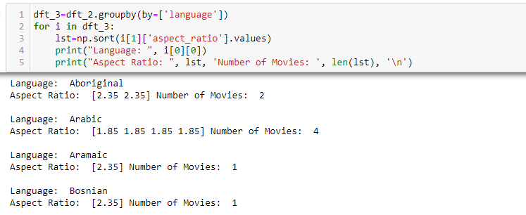
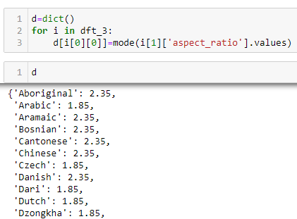
Data Pre-Processing
Action:
Getting the aspect_ratio of null values by first finding the language and their corresponding most frequent aspect_ratio. Then replacing null values of aspect_ratio with aspect_ratio value corresponding to the row’s language value as found above.

Slide 22
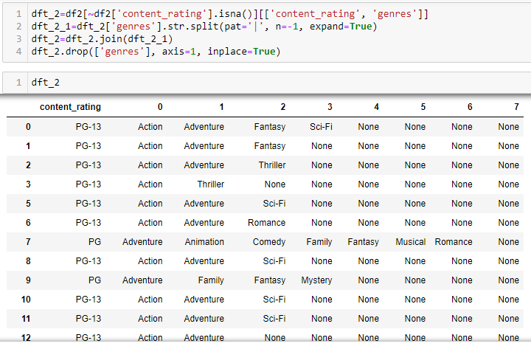
Data Pre-Processing
9. Dealing with Null values in content_rating column

Slide 23
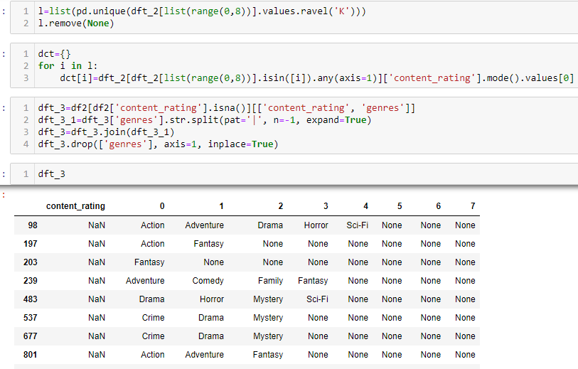
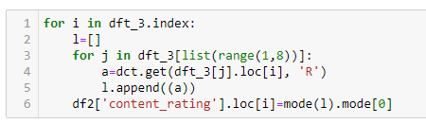
Data Pre-Processing
Action:
First, we got the most frequent content_rating for each genre from the rows which didn’t had null values for content_rating. Then we found the most common content_rating from the genres of rows with null values of content_rating and replaced them with the value we found.

Slide 24
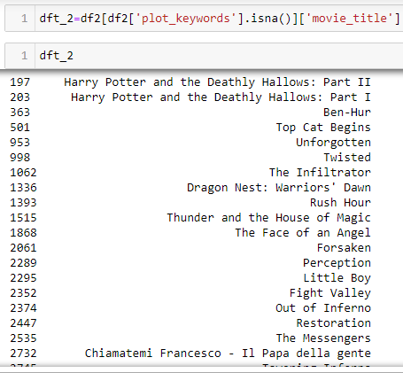
Data Pre-Processing
10. Dealing with Null values in plot_keywords column

Slide 25
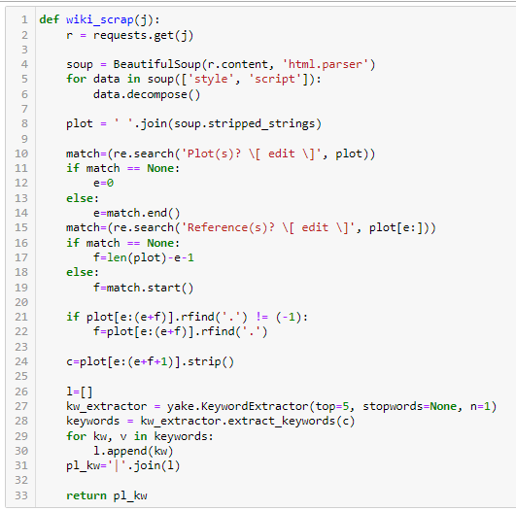
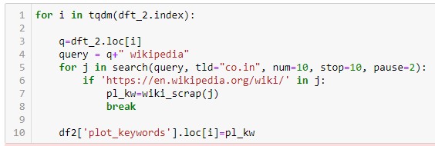
Data Pre-Processing
Action:
For each of the movie in the above dataframe, we scrapped the movie’s Wikipedia page to get a plot summary and then used KeywordExtractor function from yake library to get top 5 keywords.

Slide 26
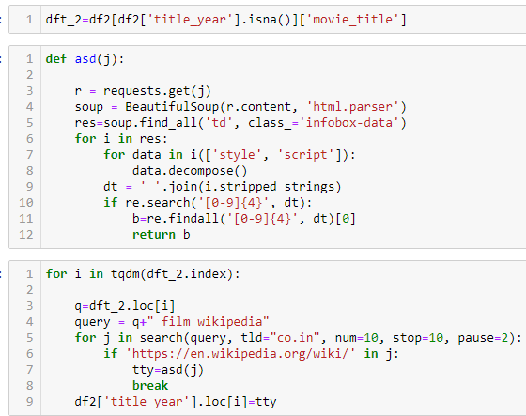
Data Pre-Processing
11 a. Dealing with Null values in title_year column
Action:
For each of the movie in the dataframe obtained by extracting rows where title_year is null, we scrapped the movie’s Wikipedia page to get the release year of the movie and store it in the original dataframe.

Slide 27
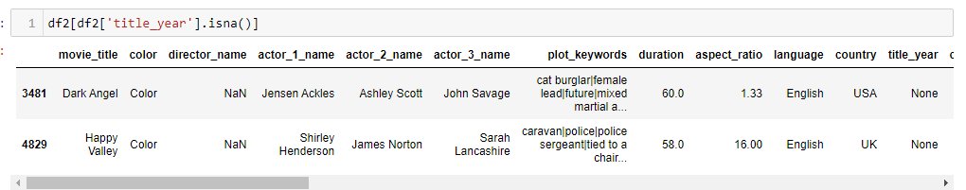
Data Pre-Processing
11 b. Dealing with Null values in title_year column which were not affected by the previous process
Action:
The title_year of above two rows are replaced manually by looking through internet.

Slide 28
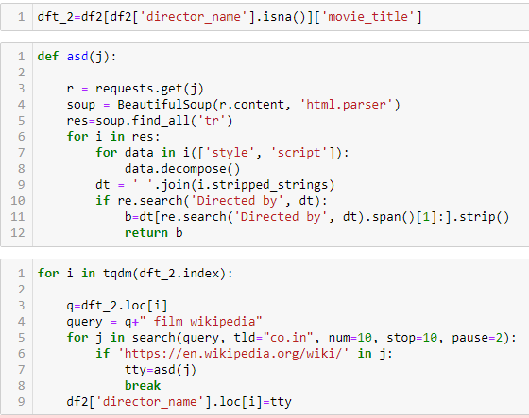
Data Pre-Processing
12 a. Dealing with Null values in director_name column
Action:
For each of the movie in the dataframe obtained by extracting rows where director_name is null, we scrapped the movie’s Wikipedia page to get director name of the movie and store it in the original dataframe.

Slide 29
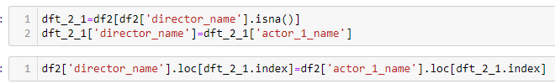
Data Pre-Processing
12 b. Dealing with Null values in director_name column which were not affected by the previous process
Action:
The director_name of such movies are replaced actor_name_1 values of the same movie

Slide 30
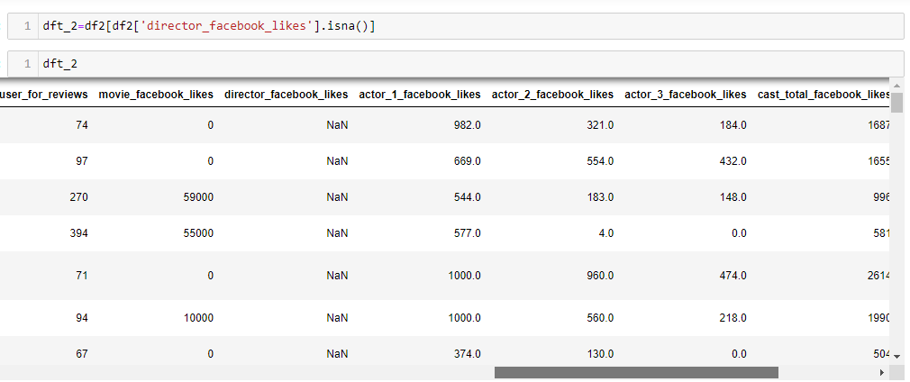
Data Pre-Processing
13 a. Dealing with Null values in director_facebook_likes column

Slide 31
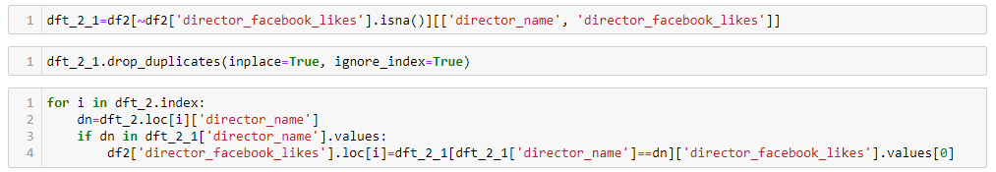
Data Pre-Processing
Action:
The director_facebook_likes of corresponding director_name are searched in the dataset and those values replaces the null values of director_facebook_likes.

Slide 32
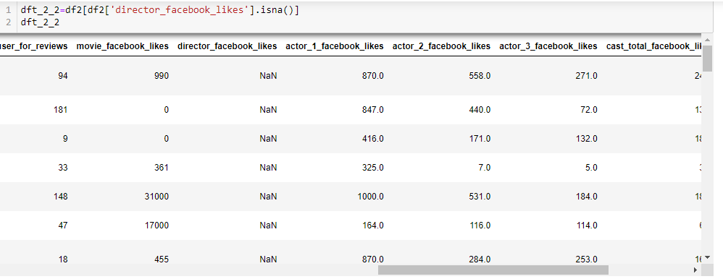
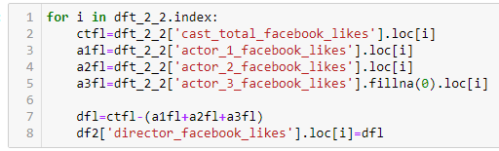
Data Pre-Processing
13 b. Dealing with Null values in director_facebook_likes column which were not affected by the previous process
Action:
The director_facebook_likes of such rows are replaced difference between cast_total_facebook_likes and sum of actor_1_facebook_likes, actor_2_facebook_likes, actor_3_facebook_likes of the same row.

Slide 33
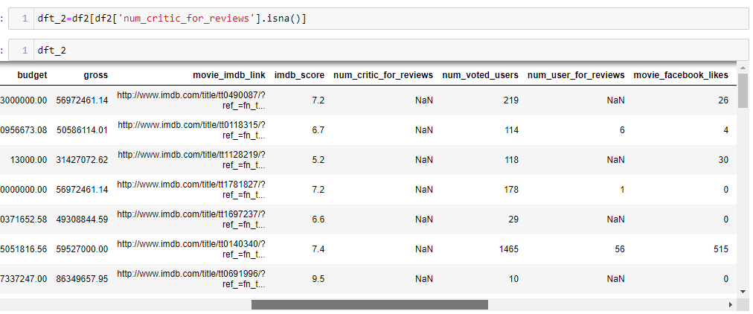
Data Pre-Processing
14. Dealing with Null values in num_critic_for_reviews column
Action:
The null values are replaced with 0.

Slide 34
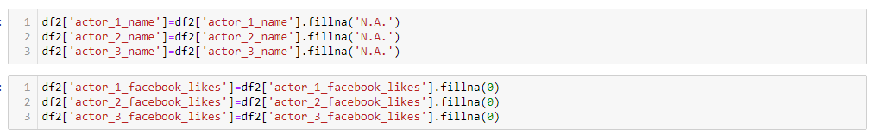
Data Pre-Processing
15. Dealing with Null values in actor_1_name, actor_2_name, actor_3_name, actor_1_facebook_likes, actor_2_facebook_likes, actor_3_facebook_likes column
Action:
The null values of actor names are replaced with ‘N.A.’ and null values of actor’s facebook likes are replaced with 0.

Slide 35

Data Pre-Processing
16. Dealing with Null values in color column
Action:
The null values of color are replaced with ‘Color’ that we found through manual check on the internet.

Slide 36
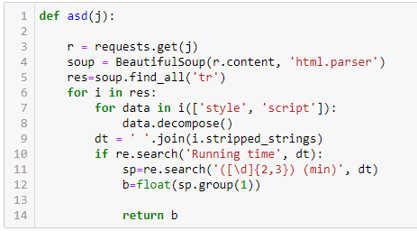
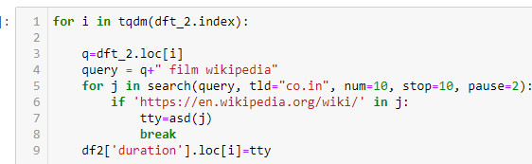
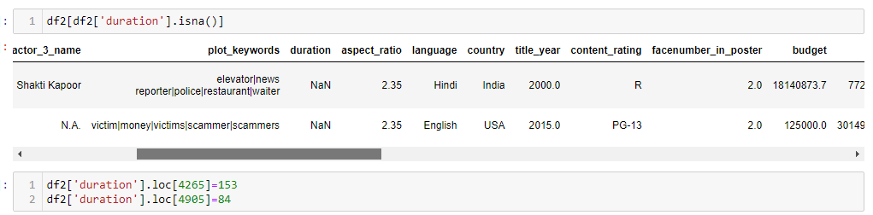
Data Pre-Processing
17 a. Dealing with Null values in duration column
Action:
For each of the movie in the dataframe obtained by extracting rows where duration is null, we scrapped the movie’s Wikipedia page to get duration of the movie and store it in the original dataframe.
17 b. Dealing with Null values in duration column which were not affected by the previous process
Action:
The null values of duration of such rows are replaced with values that we found through manual check on the internet.

Slide 37
Data Pre-Processing
18. Dealing with Null values in facenumber_in_poster column
Action:
The null values of facenumber_in_poster column of such rows are replaced with 0 after confirming them on the internet
19. Dealing with Null values in language column
Action:
The null values of language columnof such rows are replaced with ‘English’ after confirming them on the internet
20. Dealing with Null values in country column
Action:
The null values of country column of such rows are replaced with ‘USA’ after confirming them on the internet

Slide 38
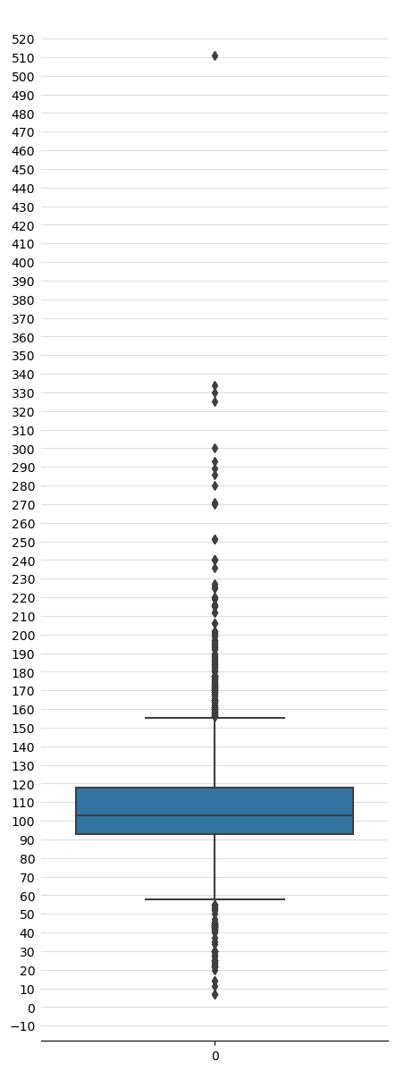
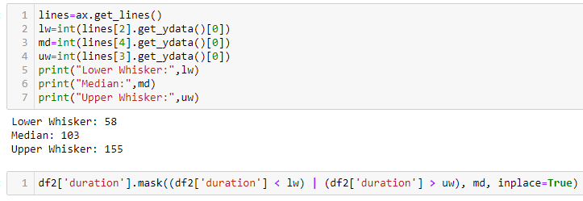
Data Pre-Processing
21. Dealing with Outliers in duration column
Action:
Replaced the values above and below the upper and lower whisker marks respectively with median.

Slide 39
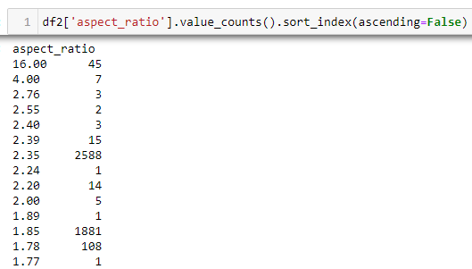
Data Pre-Processing
22. Dealing with Errors in aspect_ratio column
Action:
Only 16.00 seems to be an error which is most probably a ratio of 16/9. So replaced all row values of aspect_ratio where 16.00 is present to 1.78 (16/9)

Slide 40
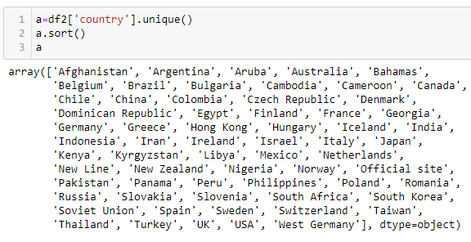
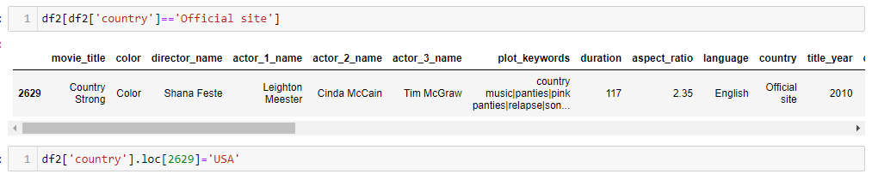
Data Pre-Processing
23. Dealing with Errors in country column
Action:
Only Official site seems to be an error which we replaced with USA after manual check on the internet

Slide 41
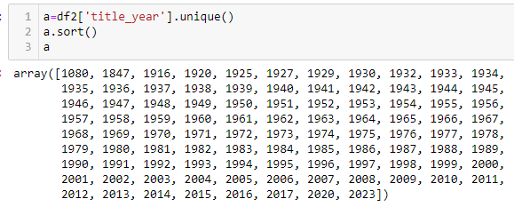
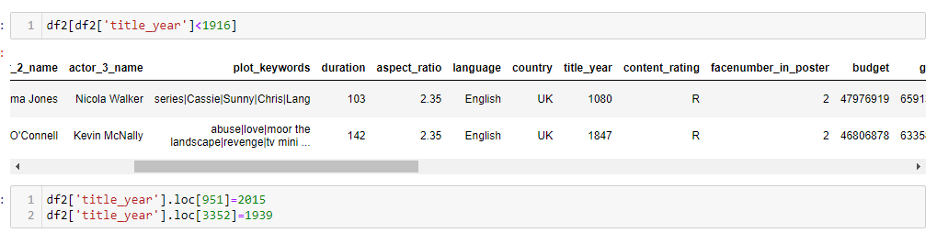
Data Pre-Processing
24. Dealing with Outliers in title_year column
Action:
Values less than 1916 seems to be outliers which we replaced with correct values of release year of the movies after manual check on the internet

Slide 42


Data Pre-Processing
25. Dealing with Outliers in budget column
Action:
Replaced values of budget less than 0 with median value
26. Dealing with Outliers in gross column
Action:
Replaced values of gross less than 0 with median value

Slide 43
Data Pre-Processing
25. Dealing with Outliers in budget column
Action:
Replaced values of budget less than 0 with median value
26. Dealing with Outliers in gross column
Action:
Replaced values of gross less than 0 with median value

Slide 44
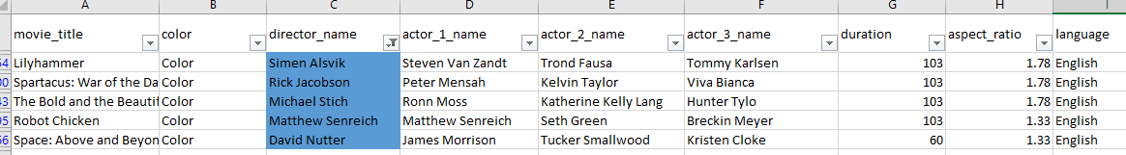
Data Pre-Processing
27. Dealing with errors in director_name column found during analysis
Action:
Replaced error values with correct name after checking on the internet. Replaced multiple names in a single row to the first name.

Slide 45
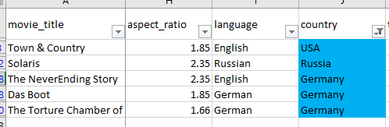
Data Pre-Processing
28. Dealing with errors in country column found during analysis
Action:
Replaced ‘New Line’ with USA, ‘Soviet Union’ with Russia and ‘West Germany’ with Germany.

Slide 46
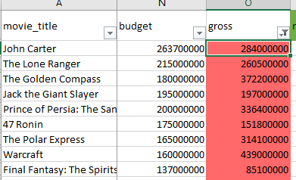
Data Pre-Processing
29. Dealing with errors in gross column found during analysis
Action:
Found that some row values of gross column have very less values. On further checking, found that they were just gross collections from USA but not World Wide collections. So replaced them with World Wide collection values after checking on the iiternet.

Slide 47
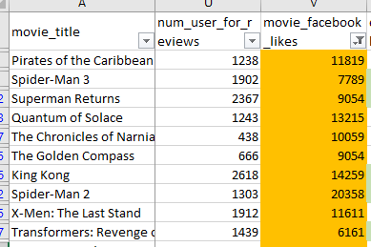
Data Pre-Processing
30. Dealing with errors in movie_facebook_likes column found during analysis
Action:
Found that some row values of movie_facebook_likes column are 0. So replaced them with average of movie_facebook_likes of corresponding imdb_score value.

Slide 48
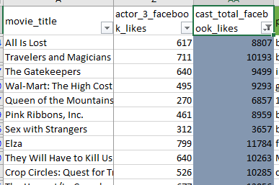
Data Pre-Processing
31. Dealing with errors in cast_total_facebook_likes column found during analysis
Action:
Found that some row values of cast_total_facebook_likes column are 0. So replaced them with average of cast_total_facebook_likes of corresponding imdb_score value.

Slide 49
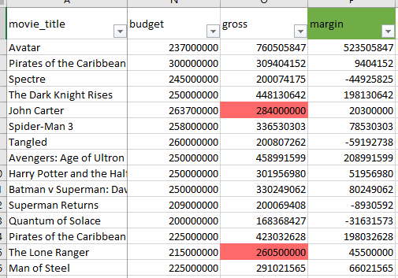
Data Pre-Processing
32. Feature Engineering involving budget and gross column.
Action:
Created a new column margin which has the difference between gross and budget values.

Slide 50
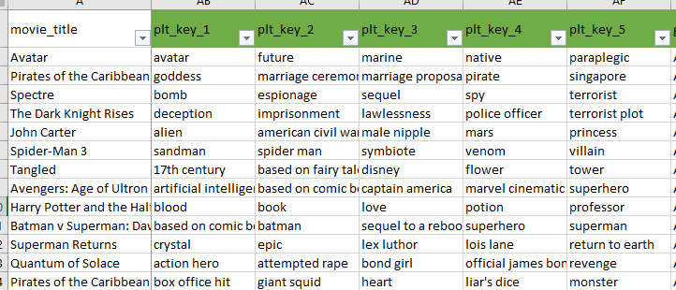
Data Pre-Processing
33. Feature Engineering involving plot_keywords column.
Action:
Seperated the plot keywords using pipe(|) as separator and then deleted the plot_keywords column.

Slide 51
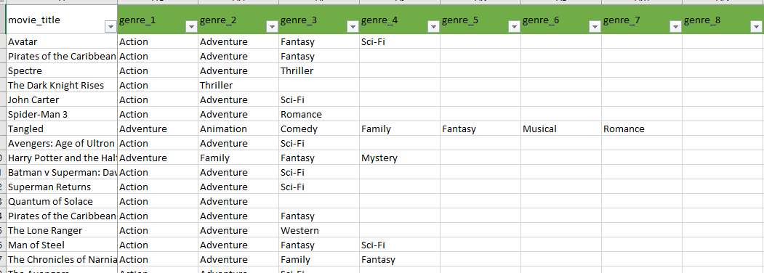
Data Pre-Processing
34. Feature Engineering involving genres column.
Action:
Seperated the genres using pipe(|) as separator and then deleted the genres column.

Slide 52
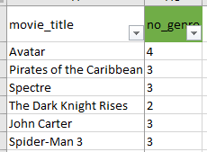
Data Pre-Processing
35. Feature Engineering involving genres column.
Action:
Created a new column no_genre which has values about the number of genres of a particular row.

Slide 53
Insights
sfdgsdfgdfg
A. Movie Genre Analysis: Analyze the distribution of movie genres and their impact on the IMDB score.
Task: Determine the most common genres of movies in the dataset. Then, for each genre, calculate descriptive statistics (mean, median, mode, range, variance, standard deviation) of the IMDB scores.
Result:
The top 7 most common genres are Drama, Comedy, Thriller, Action, Romance, Adventure and Crime.

Slide 54
Insights
sfdgsdfgdfg
A. Movie Genre Analysis: Analyze the distribution of movie genres and their impact on the IMDB score.
Task: Determine the most common genres of movies in the dataset. Then, for each genre, calculate descriptive statistics (mean, median, mode, range, variance, standard deviation) of the IMDB scores.
Result:
All the top 7 genres’ descriptive statistics are almost at same level.

Slide 55
Insights
A. Movie Genre Analysis: Analyze the distribution of movie genres and their impact on the IMDB score.
Task: Determine the most common genres of movies in the dataset. Then, for each genre, calculate descriptive statistics (mean, median, mode, range, variance, standard deviation) of the IMDB scores.
Result:
Q1. Why Drama is the most common genre?
The top 5 genres common with Drama are Comedy, Thriller, Action, Romance and Crime. These are also among the top 7 overall most common genres.

Slide 56
Insights
A. Movie Genre Analysis: Analyze the distribution of movie genres and their impact on the IMDB score.
Task: Determine the most common genres of movies in the dataset. Then, for each genre, calculate descriptive statistics (mean, median, mode, range, variance, standard deviation) of the IMDB scores.
Result:
Q2. Why Drama being the most common genre has a large Range but small Standard Deviation of IMDB Score?
The distribution of IMDB Scores of Drama Genre follows Normal Distribution closely. Since it follows Normal Distribution, we can say that 99.7% of its data lies between IMDB Score of 4.0 and 9.5. This is the reason that it's range i.e. difference between maximum score and minimum score is large but Standard Deviation is small.

Slide 57

Insights
B. Movie Duration Analysis: Analyze the distribution of movie durations and its impact on the IMDB score.
Task: Analyze the distribution of movie durations and identify the relationship between movie duration and IMDB score.
Result:
The distribution of Movie Durations shows that it closely follows a Normal Distribution.

Slide 58
Insights
B. Movie Duration Analysis: Analyze the distribution of movie durations and its impact on the IMDB score.
Task: Analyze the distribution of movie durations and identify the relationship between movie duration and IMDB score.
Result:
The adjacent scatter plot shows that duration and imdb scores have a positive relationship.

Slide 59
Insights
B. Movie Duration Analysis: Analyze the distribution of movie durations and its impact on the IMDB score.
Task: Analyze the distribution of movie durations and identify the relationship between movie duration and IMDB score.
Result:
Q1. Why do we have a positive slope treadline in the above plot?
The first plot shows that movies with higher duration is more than that of lower duration. The second plotshows that the density of the datapoints in higher duration area is high and concentrated on higher IMDB ratings area whereas density of datapoints in lower duration area is comparitively low and is distributed among higher and lower IMDB ratings area. This is the reason of positive slope treadline.

Slide 60
Insights
B. Movie Duration Analysis: Analyze the distribution of movie durations and its impact on the IMDB score.
Task: Analyze the distribution of movie durations and identify the relationship between movie duration and IMDB score.
Result:
Q2. Why movies with higher duration tend to have higher ratings?
The above plot shows that movies with higher duration has higher budgets

Slide 61
Insights
B. Movie Duration Analysis: Analyze the distribution of movie durations and its impact on the IMDB score.
Task: Analyze the distribution of movie durations and identify the relationship between movie duration and IMDB score.
Result:
Q3. Why movies with higher budget tend to have higher ratings?
The above plot shows that as budget of films increase, the popularity of casts increase. That is the producer is able to cast more popular actors and actress with increase in budget which in turn increases the popularity of the movies thus increasing its IMDB Score

Slide 62
Insights
C. Language Analysis: Situation: Examine the distribution of movies based on their language.
Task: Determine the most common languages used in movies and analyze their impact on the IMDB score using descriptive statistics.
Result:
The above left plots show that English is the most common language used in movies followed by French, Spanish, Hindi and Mandarin. The above right plot shows that French language has comparatively higher mean and median but lower variance and standard deviation implying that most of the French language movies have their imdb score on the higher side.

Slide 63
Insights
C. Language Analysis: Situation: Examine the distribution of movies based on their language.
Task: Determine the most common languages used in movies and analyze their impact on the IMDB score using descriptive statistics.
Result:
Q1. Why English is the most common language?
The adjacent plot shows that USA is the most common country in the dataset and most films in USA are in English language as it is the most spoken language in the country.

Slide 64
Insights
D. Director Analysis: Influence of directors on movie ratings.
Task: Identify the top directors based on their average IMDB score and analyze their contribution to the success of movies using percentile calculations.
Result:
The adjacent plot considers only those directors whose movie counts are more than 9 and the range of IMDB Scores is less than equal to 3 as otherwise it would be unfair for those who has maintained consistently high scores for large number of movies to be compared for top directors to those who has performed well in few movies.

Slide 65

Insights
D. Director Analysis: Influence of directors on movie ratings.
Task: Identify the top directors based on their average IMDB score and analyze their contribution to the success of movies using percentile calculations.
Result:
For top directors, only the top 7 directors are considered as there is a drop in percentile after the first 7 directors in the previous plot.
The average IMDB Scores are between 7 and 8 for the top directors with the above condition. Also their percentile score is above 80%.

Slide 66
Insights
D. Director Analysis: Influence of directors on movie ratings.
Task: Identify the top directors based on their average IMDB score and analyze their contribution to the success of movies using percentile calculations.
Result:
Q1. Why above list of directors are considered as top directors?
The above plot shows that the top 7 directors have all of their ratings on the higher side of x axis.

Slide 67
Insights
D. Director Analysis: Influence of directors on movie ratings.
Task: Identify the top directors based on their average IMDB score and analyze their contribution to the success of movies using percentile calculations.
Result:
Q2. Why above directors have their movie's rating on higher side of x axis?

Slide 68
Insights
D. Director Analysis: Influence of directors on movie ratings.
Task: Identify the top directors based on their average IMDB score and analyze their contribution to the success of movies using percentile calculations.
Result:
Q2. Why above directors have their movie's rating on higher side of x axis?

Slide 69
Insights
D. Director Analysis: Influence of directors on movie ratings.
Task: Identify the top directors based on their average IMDB score and analyze their contribution to the success of movies using percentile calculations.
Result:
Q2. Why above directors have their movie's rating on higher side of x axis?

Slide 70
Insights
D. Director Analysis: Influence of directors on movie ratings.
Task: Identify the top directors based on their average IMDB score and analyze their contribution to the success of movies using percentile calculations.
Result:
Q2. Why above directors have their movie's rating on higher side of x axis?
The above plots shows the margins of movies with respect to it's IMDB Score of the above top directors. In all the plots, we have a positive slope treadline for margins. That is with increase in margin, there is increase in IMDB Score.

Slide 71
Insights
D. Director Analysis: Influence of directors on movie ratings.
Task: Identify the top directors based on their average IMDB score and analyze their contribution to the success of movies using percentile calculations.
Result:
Q3. Why margin has a positive relation with IMDB Score for the above top directors?
The above margin vs gross plot shows that margin and gross are directly proportinal for all the top 7 directors. So high margin implies high gross collection.

Slide 72
Insights
D. Director Analysis: Influence of directors on movie ratings.
Task: Identify the top directors based on their average IMDB score and analyze their contribution to the success of movies using percentile calculations.
Result:
Q4. Why high gross collection leads to high IMDB Score for these directors?
High gross collections implies high footfall for the movies. This leads to more popularity of the movies leading to high IMDB Scores.

Slide 73

Insights
E. Budget Analysis: Explore the relationship between movie budgets and their financial success.
Task: Analyze the correlation between movie budgets and gross earnings, and identify the movies with the highest profit margin.
Result:
The above table shows that the correlation between Gross and Budget is positive and more than 0.5. That is, the relationship shows that as budget of movies increase, there is a very high probability that the gross collection of the movie will also increase.
The adjacent plot shows the relationship between Gross and Budget. The overall treadline has a slope close to 1.

Slide 74
Insights
E. Budget Analysis: Explore the relationship between movie budgets and their financial success.
Task: Analyze the correlation between movie budgets and gross earnings, and identify the movies with the highest profit margin.
Result:
Q1. Why overall treadline's slope is close to one and not greater than one?
Because of presence of Movies with negative margins.

Slide 75
Insights
E. Budget Analysis: Explore the relationship between movie budgets and their financial success.
Task: Analyze the correlation between movie budgets and gross earnings, and identify the movies with the highest profit margin.
Result:
Q2. Why movies have negative margins?
Many Movies with negative margin typically have high IMDB Scores.

Slide 76
Insights
E. Budget Analysis: Explore the relationship between movie budgets and their financial success.
Task: Analyze the correlation between movie budgets and gross earnings, and identify the movies with the highest profit margin.
Result:
Q3. Why many Movies with negative margins have high IMDB Scrores?
Top 5 genres for movies with negative margins and 5 or more IMDB Scores are Biography, War, History, Sport and Documentary. These genres have domain specific target audience. So IMDB Score can be high as critics might like the movies but number of footfalls will be low leading to less Gross collection and negative margin.

Slide 77
Insights
E. Budget Analysis: Explore the relationship between movie budgets and their financial success.
Task: Analyze the correlation between movie budgets and gross earnings, and identify the movies with the highest profit margin.
Result:
Q4. Why some Movies with negative margins have low IMDB Scrores?
Top 5 genres for movies with negative margins and less than 5 IMDB Scores are Sci-Fi, Fantasy, Horror, Family and Musical. Although the percentage of films here is very less but still these are popular genres and ideally they should not have negative margins.

Slide 78
Insights
E. Budget Analysis: Explore the relationship between movie budgets and their financial success.
Task: Analyze the correlation between movie budgets and gross earnings, and identify the movies with the highest profit margin.
Result:
Q5. Why movies of popular genres have low IMDB Scores and negative margins?
Movies with IMDB Score less than 5 have cast whose total facebook likes are very low. That is their casts are not popular. So movies became less popular.

Slide 79

Result
Through this project, I was able to understand the importance of Data Analytics in Movies analysis as it provides valuable insights such as director’s relationship with IMDB Score, genre’s relationship with IMDB Score, budget’s relationship with IMDB Score etc. which helps in making Data-Driven Decisions.
In this project I was able to get insights about various questions like relationship between budget and gross collections, relationship between genres and ratings etc. I also got experience in Data Preprocessing like Data Cleaning, handling Outliers, Feature Engineering etc. in this project. I can communicate the insights to relevant stakeholders as per the requirements using which they can make proper data-driven decisions.
This Project has also helped me in understanding the various functions of MS-Excel and Python and its working.
Image Source: Google Images

Slide 80
Thank You

